Slide 1

Nine New Things in
Java 9
Nick Maiorano

Slide 2
Part 1: Introduction
Nine New Things in Java 9

Slide 3

85 JEPs in Java 9
Introduction
102: Process API Updates 248: Make G1 the Default Garbage Collector
110: HTTP 2 Client 249: OCSP Stapling for TLS
143: Improve Contended Locking 250: Store Interned Strings in CDS Archives
158: Unified JVM Logging 251: Multi-Resolution Images
165: Compiler Control 252: Use CLDR Locale Data by Default
193: Variable Handles 253: Prepare JavaFX UI Controls & CSS APIs for Modularization
197: Segmented Code Cache 254: Compact Strings
199: Smart Java Compilation, Phase Two 255: Merge Selected Xerces 2.11.0 Updates into JAXP
200: The Modular JDK 256: BeanInfo Annotations
201: Modular Source Code 257: Update JavaFX/Media to Newer Version of GStreamer
211: Elide Deprecation Warnings on Import Statements 258: HarfBuzz Font-Layout Engine
212: Resolve Lint and Doclint Warnings 259: Stack-Walking API
213: Milling Project Coin 260: Encapsulate Most Internal APIs
214: Remove GC Combinations Deprecated in JDK 8 261: Module System
215: Tiered Attribution for javac 262: TIFF Image I/O
216: Process Import Statements Correctly 263: HiDPI Graphics on Windows and Linux
217: Annotations Pipeline 2.0 264: Platform Logging API and Service
219: Datagram Transport Layer Security (DTLS) 265: Marlin Graphics Renderer
220: Modular Run-Time Images 266: More Concurrency Updates
221: Simplified Doclet API 267: Unicode 8.0
222: jshell: The Java Shell (Read-Eval-Print Loop) 268: XML Catalogs
223: New Version-String Scheme 269: Convenience Factory Methods for Collections
224: HTML5 Javadoc 270: Reserved Stack Areas for Critical Sections
225: Javadoc Search 271: Unified GC Logging
226: UTF-8 Property Files 272: Platform-Specific Desktop Features
227: Unicode 7.0 273: DRBG-Based SecureRandom Implementations
228: Add More Diagnostic Commands 274: Enhanced Method Handles
229: Create PKCS12 Keystores by Default 275: Modular Java Application Packaging
231: Remove Launch-Time JRE Version Selection 276: Dynamic Linking of Language-Defined Object Models
232: Improve Secure Application Performance 277: Enhanced Deprecation
233: Generate Run-Time Compiler Tests Automatically 278: Additional Tests for Humongous Objects in G1
235: Test Class-File Attributes Generated by javac 279: Improve Test-Failure Troubleshooting
236: Parser API for Nashorn 280: Indify String Concatenation
237: Linux/AArch64 Port 281: HotSpot C++ Unit-Test Framework
238: Multi-Release JAR Files 282: jlink: The Java Linker
240: Remove the JVM TI hprof Agent 283: Enable GTK 3 on Linux
241: Remove the jhat Tool 284: New HotSpot Build System
243: Java-Level JVM Compiler Interface 285: Spin-Wait Hints
244: TLS Application-Layer Protocol Negotiation Extension 287: SHA-3 Hash Algorithms
245: Validate JVM Command-Line Flag Arguments 288: Disable SHA-1 Certificates
246: Leverage CPU Instructions for GHASH and RSA 289: Deprecate the Applet API
247: Compile for Older Platform Versions 290: Filter Incoming Serialization Data
292: Implement Selected ECMAScript 6 Features in Nashorn
Nine New Things in Java 9

Slide 4
“If Java 8 was all about coding,
Java 9 is all about design”
Nine New Things in Java 9

Slide 5
Themes
Java 9
Functional
Reactive
Fluent interface style
Streams
Modular
Nine New Things in Java 9

Slide 6
Java 9 GA
September 2016
March 2017
July 27, 2017
September 21, 2017
Nine New Things in Java 9

Slide 7
Part 2: The countdown
Nine New Things in Java 9

Slide 8
#9: Syntactical changes
Nine New Things in Java 9

Slide 9
#9: Syntactical changes
Private default methods in interfaces
public interface MyJava9Interface {
private void sayHello(){
System.out.println(“hello!”);
}
Nine New Things in Java 9

Slide 10
#9: Syntactical changes
Try-With-Resources on Effectively Final Variables
void doSomethingWith(MyCloseable mc) throws IOException {
try(MyCloseable finalCloseable = mc) {
finalCloseable.doSomething();
}
}
void doSomethingWith(MyCloseable mc) throws IOException {
try(mc) {
mc.doSomething();
}
}
Nine New Things in Java 9

Slide 11
#9: Syntactical changes
Diamond Operator for anonymous classes
<T> Holder<T> createHolder(T data) {
return new Holder<T>(data) { };
}
<T> Holder<T> createHolder(T data) {
return new Holder<>(data) { };
}
Nine New Things in Java 9

Slide 12
#8: Stream API changes
Nine New Things in Java 9

Slide 13
#8: Stream API changes
Stream<T> takeWhile(Predicate<? super T> predicate);
Stream<T> dropWhile(Predicate<? super T> predicate);
Stream<T> iterate(T seed, Predicate<? super T> hasNext,
UnaryOperator<T> next);
Stream<T> ofNullable(T t);
Nine New Things in Java 9

Slide 14
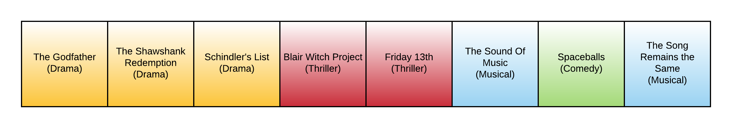
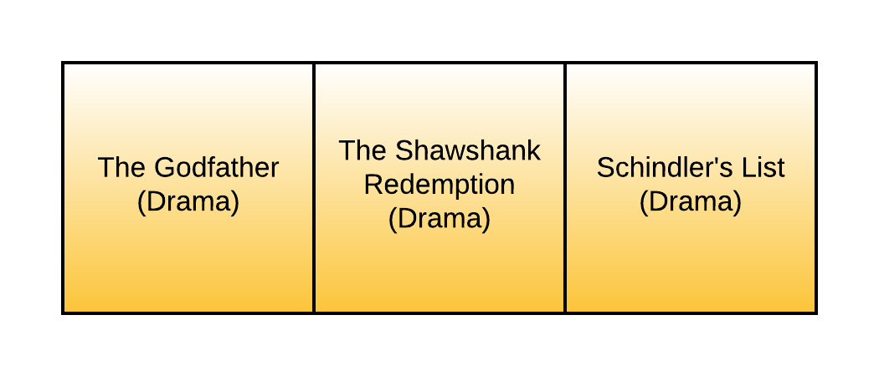
#8: Stream API changes
stream.takeWhile(movie -> movie.type == DRAMA)…
Nine New Things in Java 9

Slide 15
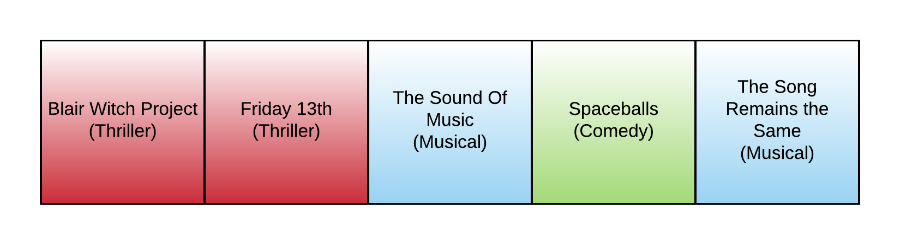
#8: Stream API changes
stream.dropWhile(movie -> movie.type == DRAMA)…
Nine New Things in Java 9

Slide 16
#8: Stream API changes
Ideal for
Stream samples
Ordered streams
Infinite streams
Also works for
Parallel streams
May be less efficient
Nine New Things in Java 9

Slide 17
#7: Process API
Nine New Things in Java 9

Slide 18
#7: Process API
Process API was limited → enriched
New ProcessHandle and Info classes
Get PIDs, navigate parent/child PIDs
Start & stop PIDs, get CPU stats
Uses Streams, Optionals & promises
Nine New Things in Java 9

Slide 19
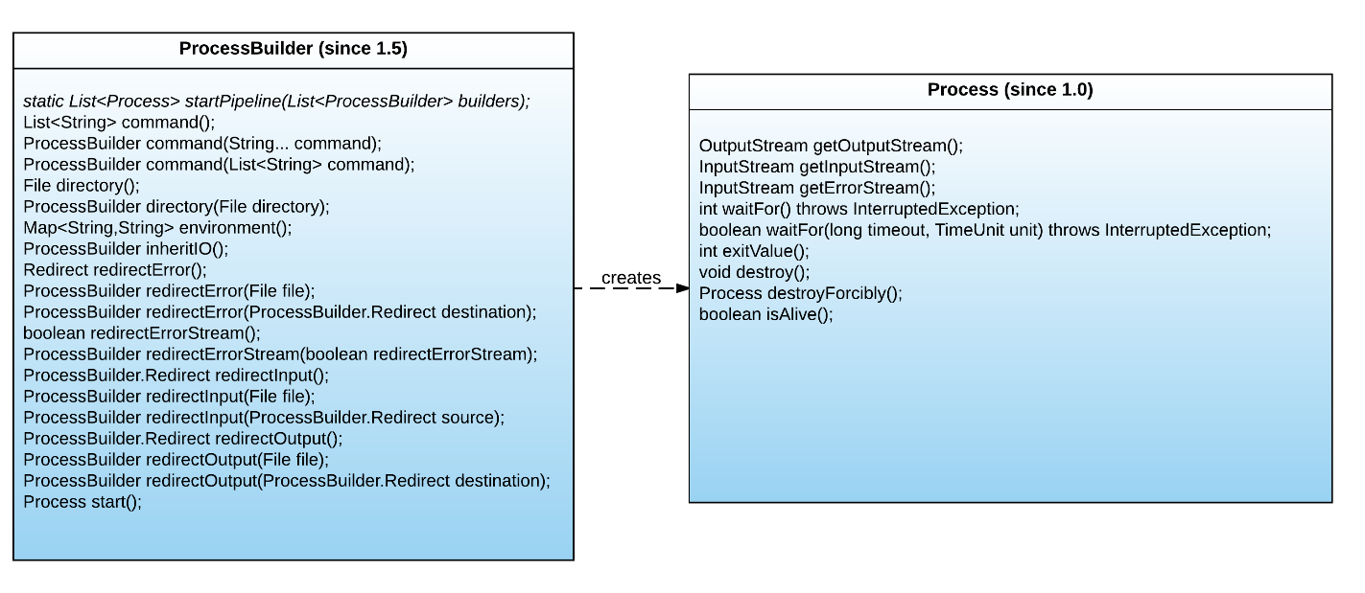
#7: Process API
Nine New Things in Java 9

Slide 20
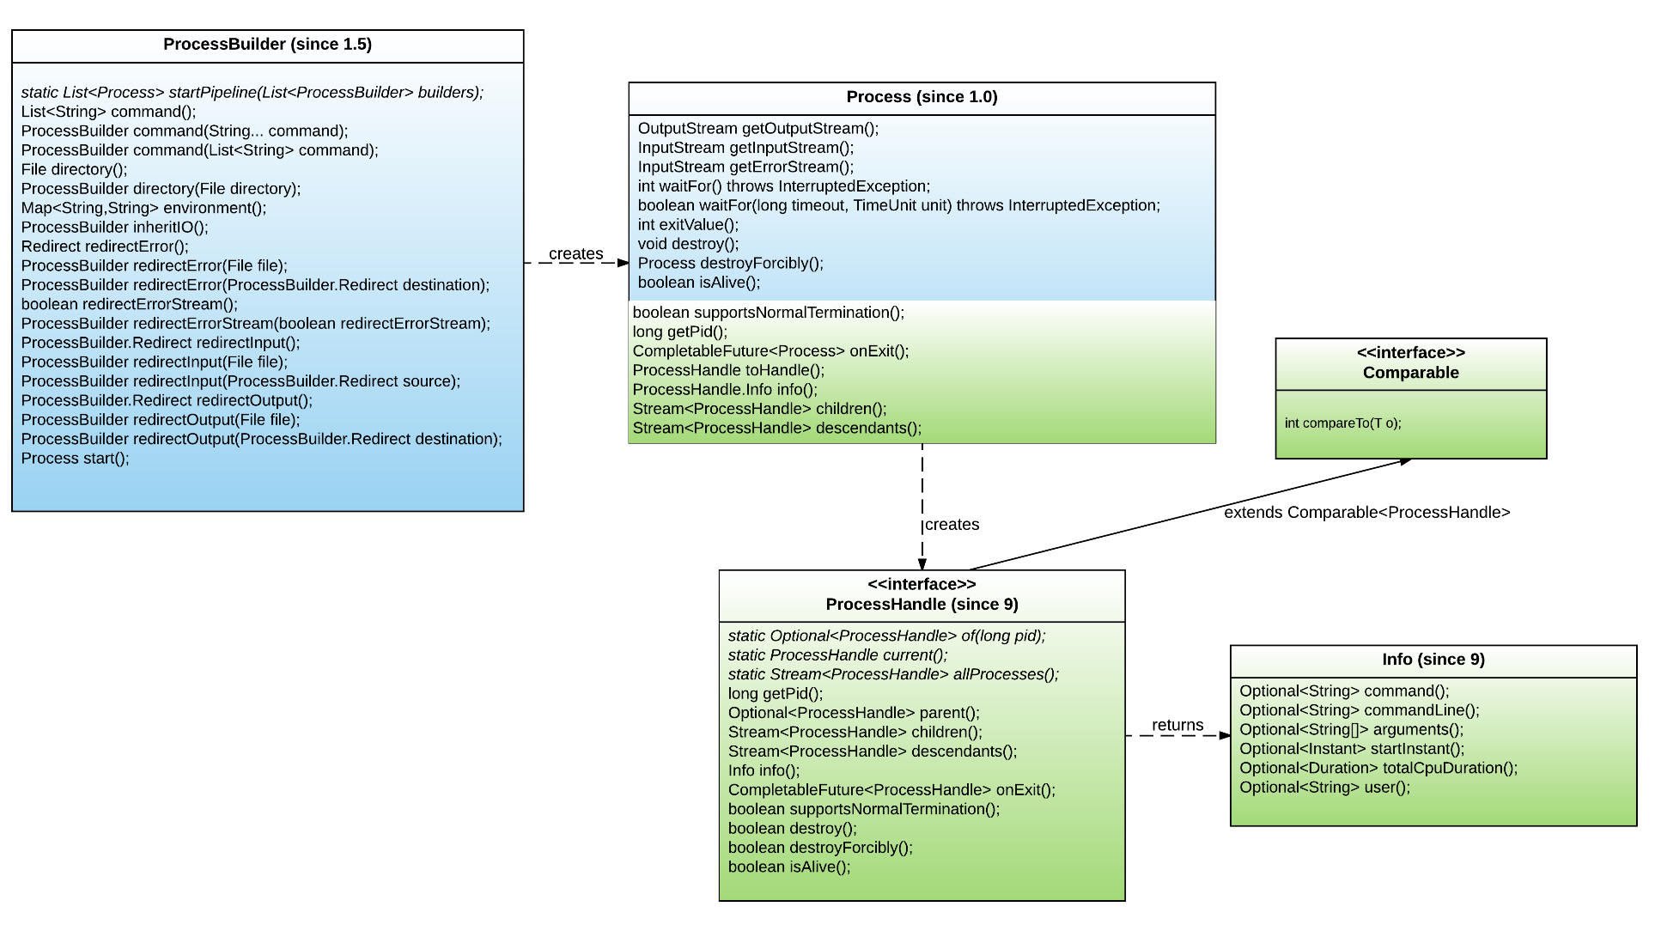
#7: Process API
Nine New Things in Java 9

Slide 21
#7: Process API
ProcessHandle handle = ProcessHandle.of(1234)
.orElseThrow(() -> new RuntimeException());
handle.descendants().forEach(System.out::println);
Nine New Things in Java 9

Slide 22
#6: The Rise of G1
Nine New Things in Java 9

Slide 23
#6: The Rise of G1
“Garbage first” introduced in Java 7
Mature, replaces CMS as default
Nine New Things in Java 9

Slide 24
#6: The Rise of G1
“Garbage first” introduced in Java 7
Mature, replaces CMS as default
Facet | CMS | G1
Minimize pause times
Mark and sweep
Compaction
Best throughput | Parallel
Best out-of-the-box
Best when tuned
Nine New Things in Java 9

Slide 25
#6: The Rise of G1
GC landscape
Collectors | GC strategy | Compaction strategy
Serial | STW using 1 thread | STW
Parallel | STW (using all available cores) | STW
CMS | Mostly concurrent | None
G1 | Mostly concurrent | STW
Shenandoah | Mostly concurrent | Mostly concurrent (fedora Linux)
Nine New Things in Java 9

Slide 26
#5: Reactive Java
Nine New Things in Java 9

Slide 27
#5: Reactive Java
Responsive
Resilient
Elastic
Message driven
A declaration of ideals for modern software design. It proposes these four qualities as its central pillars for modern software.
Reactive
Manifesto
Nine New Things in Java 9
Notes:
The reactive manifesto (by Jonas Bonér, Dave Farley, Roland Kuhn, and Martin Thompson)
2014
Responsive: The system responds in a timely manner with reliable upper bounds.
Resilient: The system stays responsive in the face of failure.
Elastic: The system stays responsive under varying workload and can react to workload changes by resource allocation/deallocation.
Message driven: Asynchronous message-passing to ensure loose coupling, isolation and location transparency.

Slide 28
#5: Reactive Java
Publisher
Subscriber
Processor
Subscription
Reactive Streams is an organization that created a spec dictating how to achieve the manifesto objectives. It created these four components and a set of rules for their interactions with one another.
Reactive Streams
Nine New Things in Java 9
Notes:
This led to an effort by reactive streams.org (primarily from Kaazing, Netflix, Pivotal, RedHat, Twitter, Typesafe) to provide a specification with (~40-odd) rules dictating how to achieve the objectives of the reactive manifesto.

Slide 29
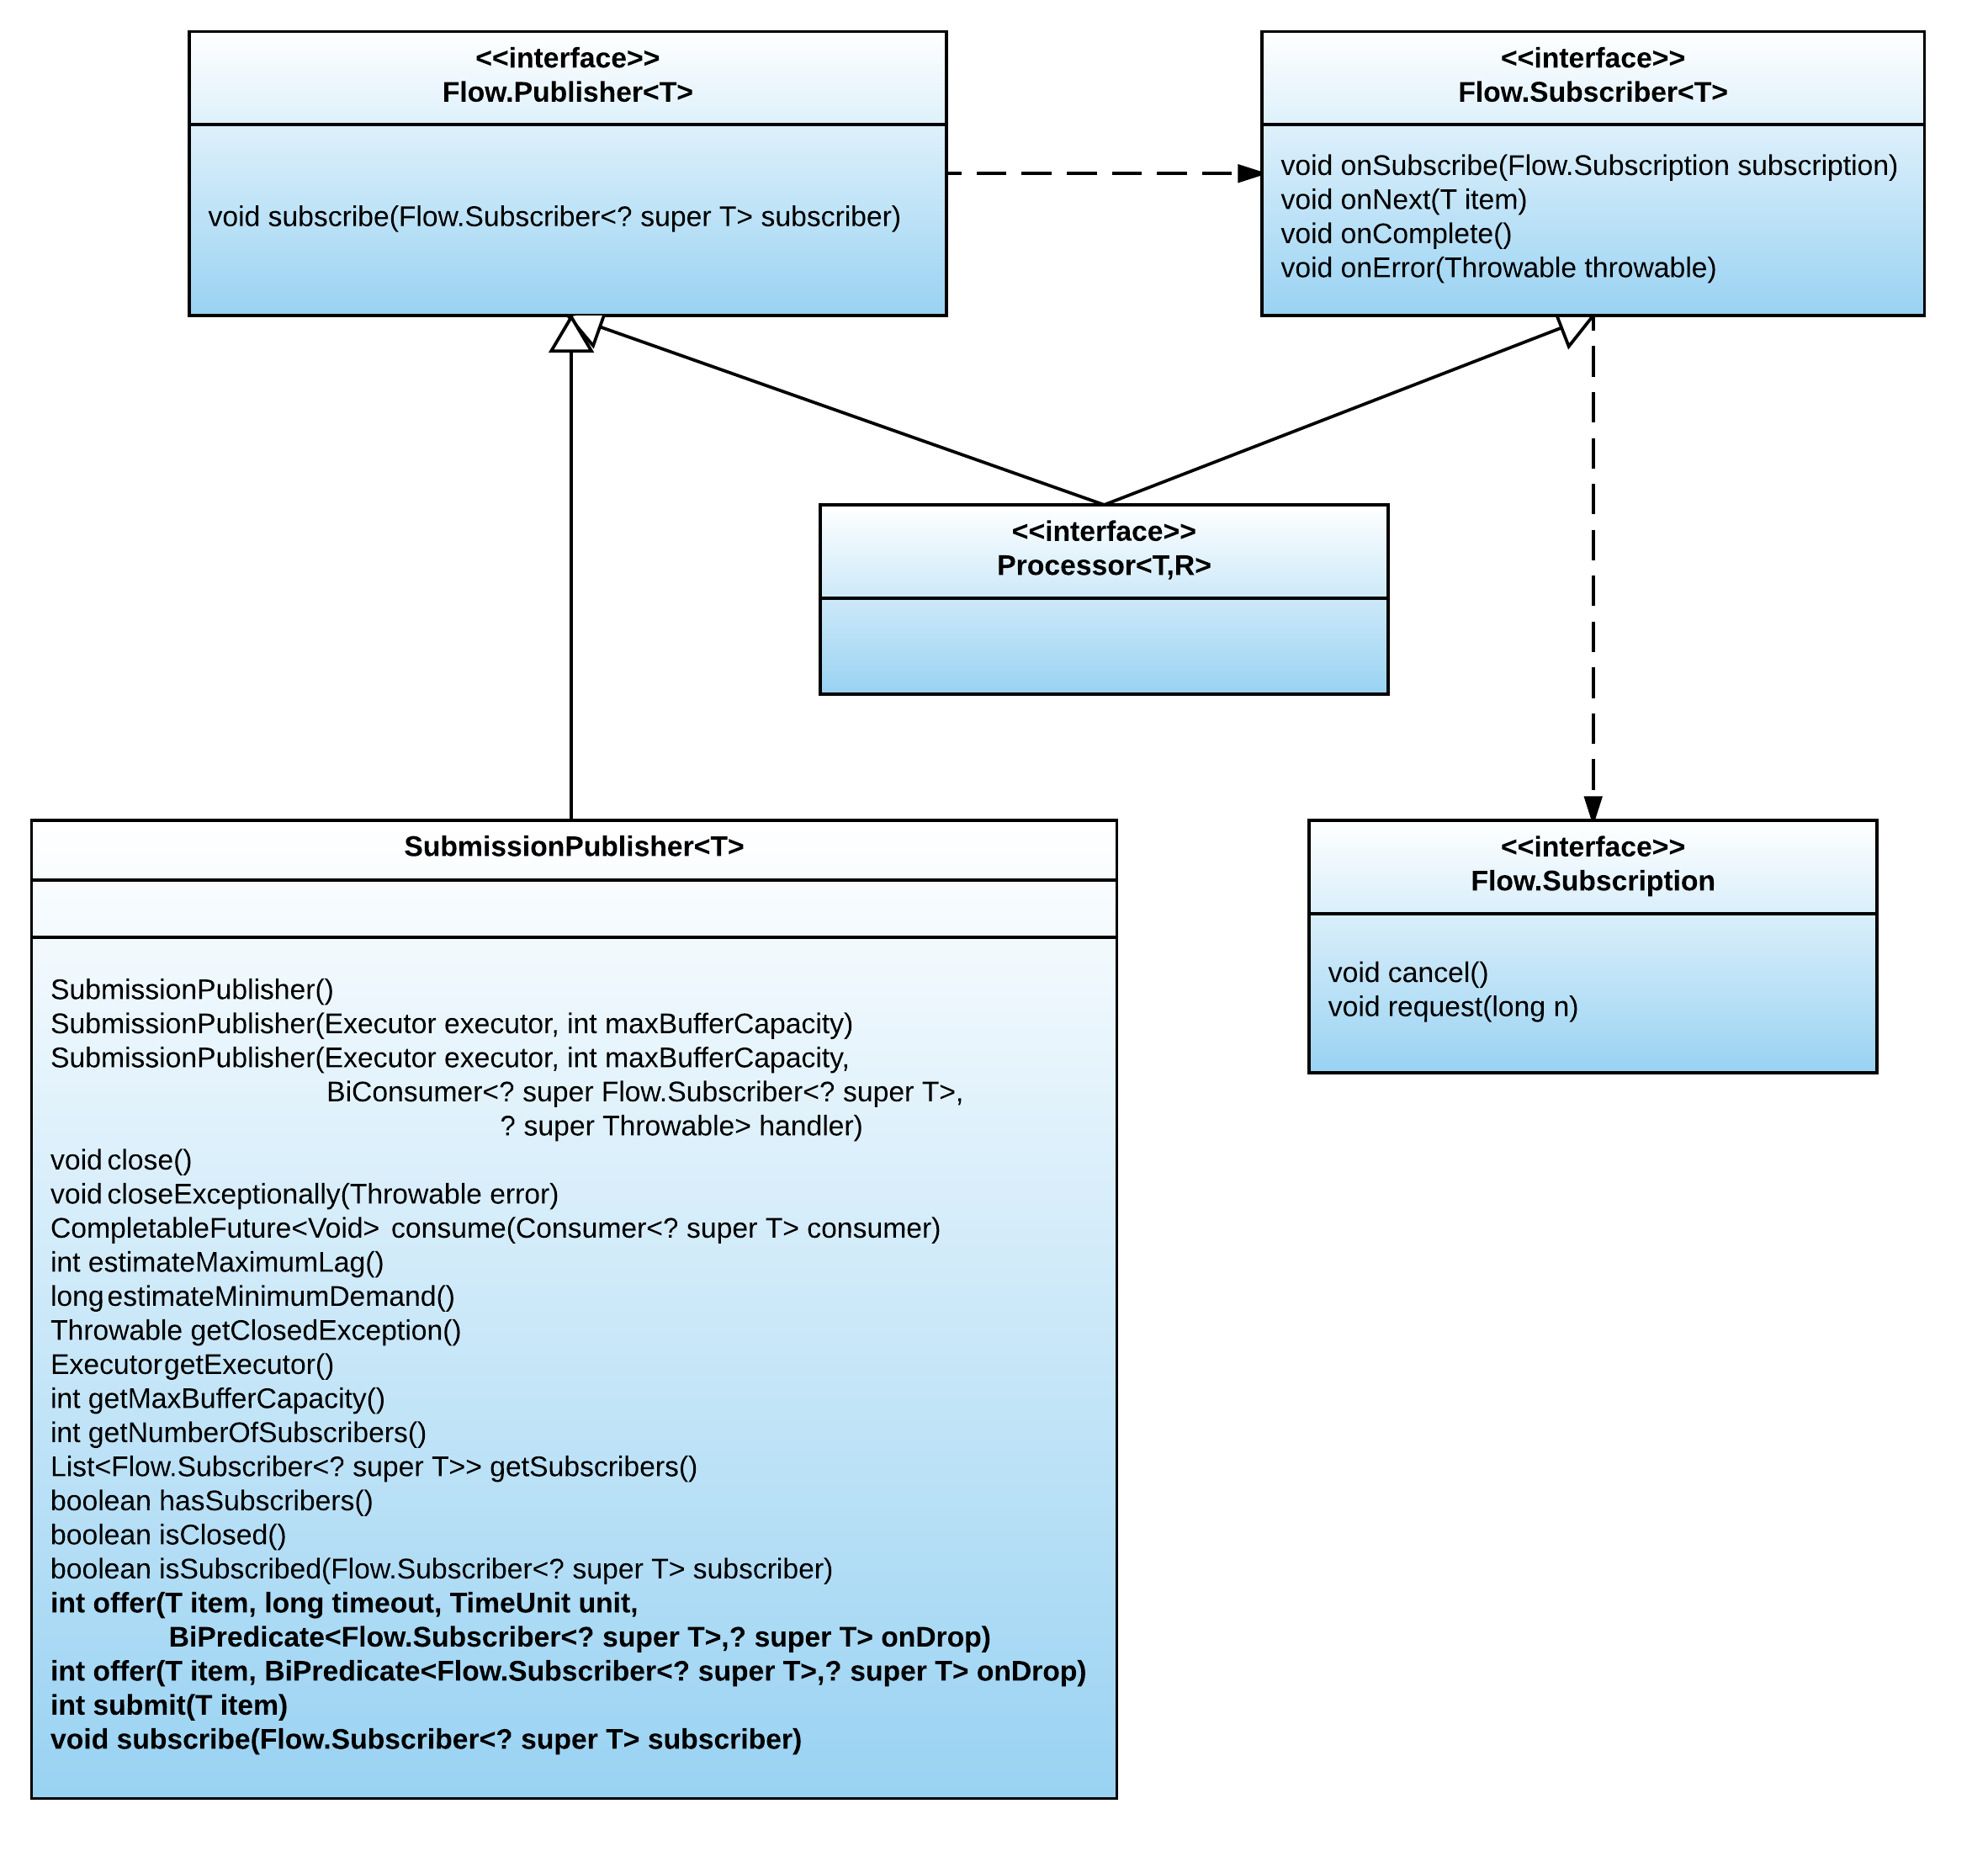
#5: Reactive Java
Nine New Things in Java 9
Notes:
SubmissionPublisher (implements publisher) Using a SubmissionPublisher allows item generators to act as compliant reactive-streams Publishers relying on drop handling and/or blocking for flow control.

Slide 30
#4: HTTP 2
Nine New Things in Java 9

Slide 31
#4: HTTP 2
History of
HTTP 2
SPDY protocol
Supported by most browsers
RFC 7540
(May 2015)
Nine New Things in Java 9

Slide 32
#4: HTTP 2
What’s new in HTTP 2?
1
Binary protocol
2
Header compression
3
Server push
4
Multiplexing over one TCP connection
5
HOL blocking solution
Nine New Things in Java 9

Slide 33
#4: HTTP 2
HTTP 1.1
HTTP just another protocol
Hard to use
Undocumented
behaviors
Blocking mode only
Gopher
support!
Nine New Things in Java 9

Slide 34
#4: HTTP 2
HTTP 2
1st class citizen
HttpClient
HttpRequest
HttpResponse
WebSocket
TLS support
Async support
Nine New Things in Java 9

Slide 35
#4: HTTP 2
HTTP get
HttpResponse response =
HttpRequest.create(new URI("http://www.google.ca")).
GET().response();
int statusCode = response.statusCode();
String body = response.body(HttpResponse.asString());
Nine New Things in Java 9

Slide 36
#4: HTTP 2
HTTP post
HttpResponse = HttpRequest
.create(new URI("http://www.confoo.com"))
.body(fromString("param1=con,param2=foo"))
.POST()
.response();
int statusCode = response.statusCode();
String body = response.body(HttpResponse.asString());
Nine New Things in Java 9

Slide 37
#4: HTTP 2
HTTP get with promises
CompletableFuture<HttpResponse> promiseResponse =
HttpRequest.create(new URI("http://www.google.ca")).
GET().
responseAsync();
HttpResponse resp = promiseResponse.get();
Nine New Things in Java 9

Slide 38
#3: Jshell
Nine New Things in Java 9

Slide 39
#3: Jshell
Jshell: Java’s me-too REPL engine
R ead
P rint
L oop
E val
Quickly test out ideas
No need to write throwaway code
Lowers barrier of entry into Java
Great way to teach kids and next generation of coders
Nine New Things in Java 9

Slide 40
#3: Jshell
Pre-imported packages
math
io
util
net
concurrent
prefs
regex
Nine New Things in Java 9

Slide 41
#3: Jshell
Create
methods
interfaces
classes
expressions
Nine New Things in Java 9

Slide 42
#3: Jshell
Save snippets
reload
edit
replay
Nine New Things in Java 9

Slide 43
#3: Jshell
Demo
Nine New Things in Java 9

Slide 44
#2: Jigsaw – the concept
Nine New Things in Java 9

Slide 45
#2: Jigsaw – the concept
Jigsaw is all about modularity
Nine New Things in Java 9

Slide 46

#2: Jigsaw – the concept
*
*Not modular
Nine New Things in Java 9

Slide 47
#2: Jigsaw – the concept
Monoliths don’t give you
Encapsulability
Interoperability
Recomposability
Expandability
Autonomy
Nine New Things in Java 9

Slide 48
#2: Jigsaw – the concept
Modularity must also consider
Manifest
of interoperability
Reliable interoperability
Strong encapsulation
Footprint scaling
Nine New Things in Java 9

Slide 49
#2: Jigsaw – the concept
What does Jigsaw give you?
Manifest of
interoperability
Smaller footprint
Strong encapsulation
Reliable configuration
Self-describing modules
Fidelity across building phases
Access-limiting semantics
Less classes to load, faster startup time
Nine New Things in Java 9

Slide 50

#2: Jigsaw – the concept
What does Jigsaw give you?
Nine New Things in Java 9

Slide 51
#2: Jigsaw – the concept
How is modularity offered?
Declaratively via module-info.java
Modules are a new unit of compilation
One-to-one with root package
Defined by reverse domain at top level
Nine New Things in Java 9

Slide 52
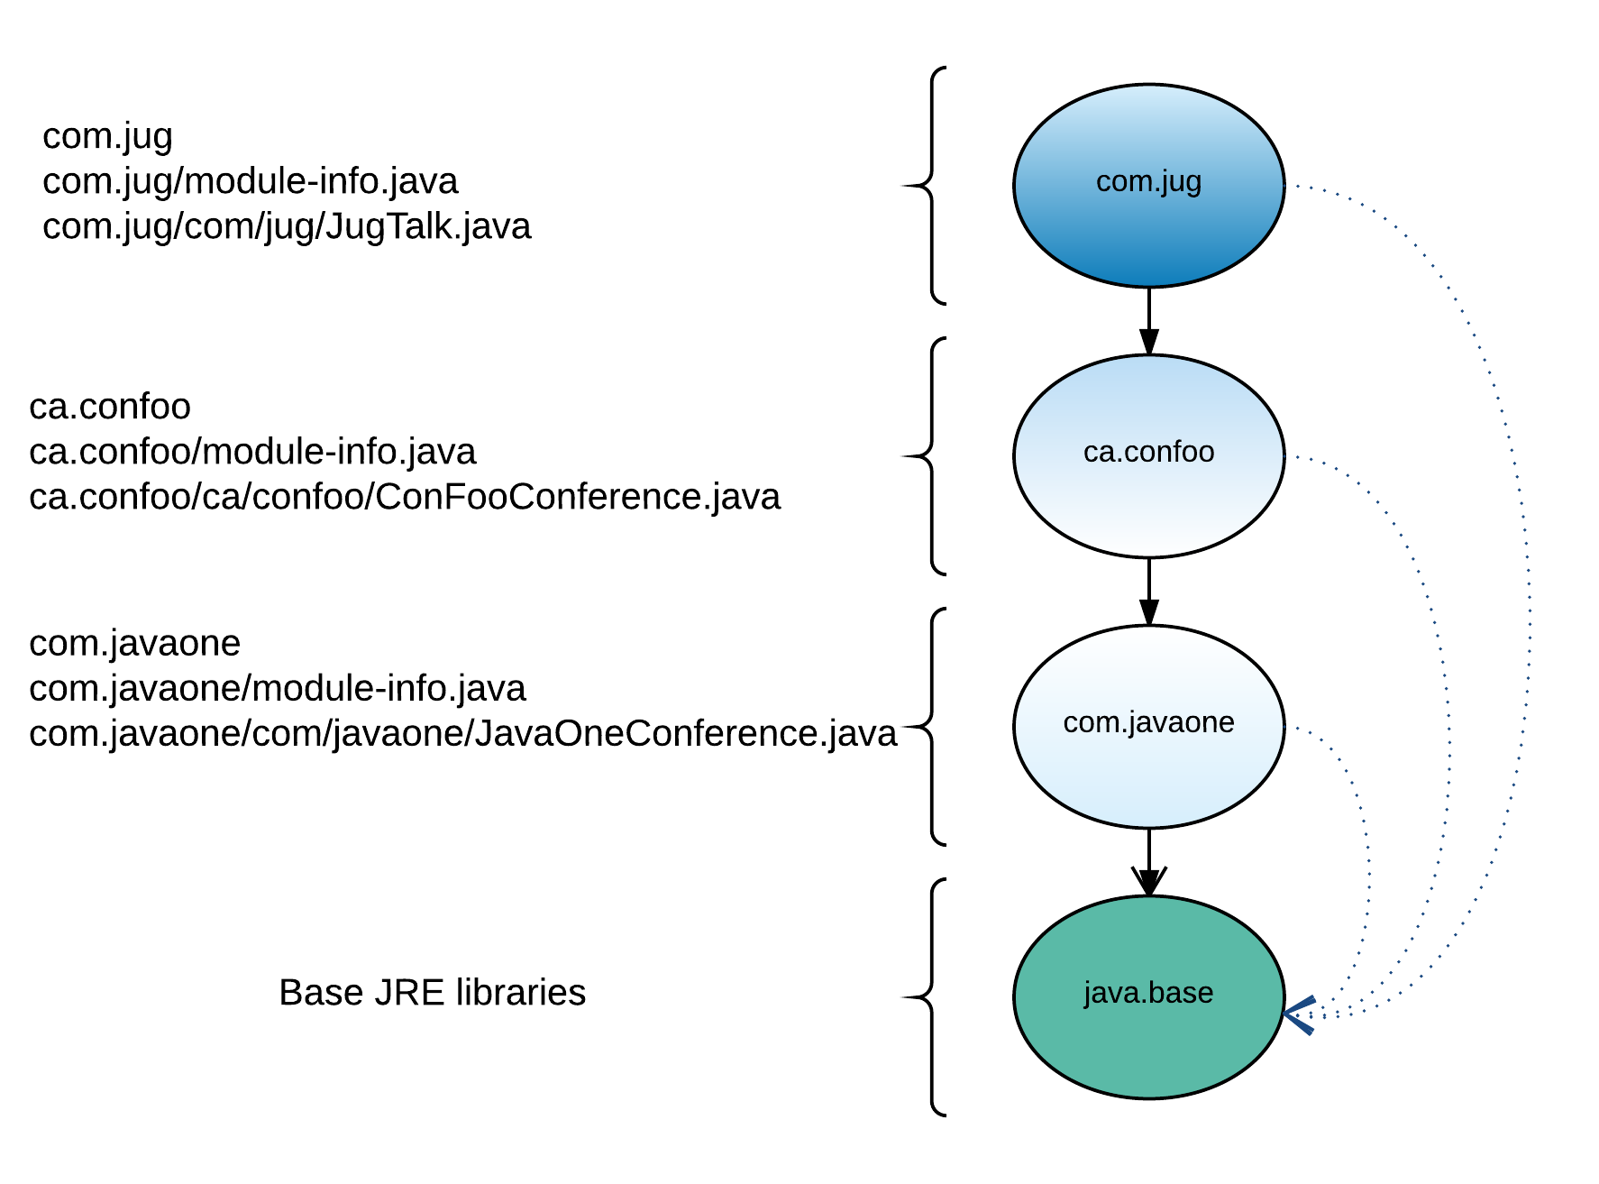
#2: Jigsaw – the concept
Nine New Things in Java 9

Slide 53
#2: Jigsaw – the concept
Module-info.java
module com.javaone {
exports com.javaone;
}
module ca.confoo {
requires com.javaone;
exports com.confoo;
}
module com.jug {
requires ca.confoo;
}
Nine New Things in Java 9

Slide 54
#2: Jigsaw – the concept
How is modularity offered?
New syntax to express dependencies:
Exports
Export … to …
Requires [transitive] [static]
Uses
Provides … with…
Opens
Nine New Things in Java 9

Slide 55
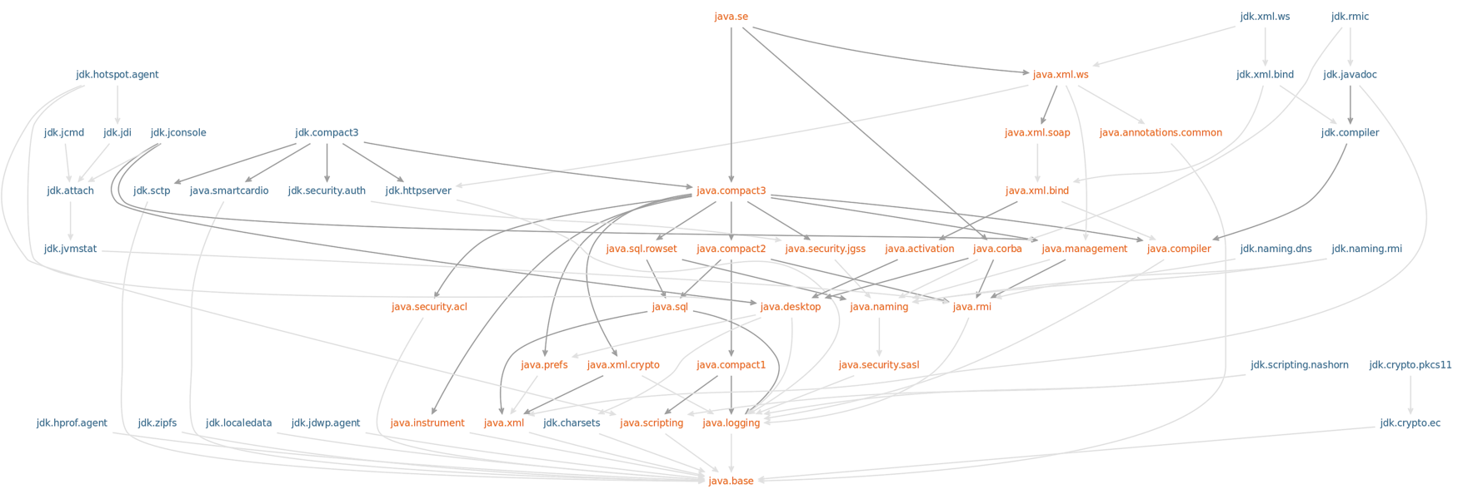
#2: Jigsaw – the concept
Nine New Things in Java 9

Slide 56

#2: Jigsaw – the concept
What about backward compatibility?
Can still use classpaths and ignore modules
Can combine both
Unmodularized code -> Unnamed module:
Free-for-all
Nine New Things in Java 9

Slide 57
#1: Jigsaw – the tools
Nine New Things in Java 9

Slide 58
#1: Jigsaw – the tools
Modular compilation
Modular execution
javac
java
jdep
jlink
Modular dependencies
Modular images
Nine New Things in Java 9

Slide 59
#1: Jigsaw – the tools
Modular builds
javac -d outputpath --module-path modulepath \
$(find specificpath -name “*.java”)
java --module-path modulepath -m module/className
Nine New Things in Java 9

Slide 60
#1: Jigsaw – the tools
Modular dependencies
jdeps --module-path . com.jug
com.jug
requires ca.confoo
requires mandated java.base
com.jug -> ca.confoo
com.jug -> java.base
com.jug -> ca.confoo ca.confoo
com.jug -> java.lang java.base
Nine New Things in Java 9

Slide 61
#1: Jigsaw – the tools
Modular images
jlink --module-path $JAVA_HOME/path:. \
--add-modules com.jug --output jugtalk
path/jugtalk
Nine New Things in Java 9

Slide 62
Part 3: Final thoughts
Nine New Things in Java 9

Slide 63
What about OSGI?
Nine New Things in Java 9

Slide 64
What about OSGI?
OSGI vs. Jigsaw
Services
Native modularity
Runtime
Package encapsulation
Reliable configuration
Component lifecycle
management
Modularity
Compile-time
dependency checking
Self-describing modules
Nine New Things in Java 9

Slide 65
What about OSGI?
OSGI vs. Jigsaw
OSGI
Services
Native modularity
Runtime
Package encapsulation
Reliable configuration
Component lifecycle
management
Modularity
Compile-time
dependency checking
Self-describing modules
Nine New Things in Java 9

Slide 66
What about OSGI?
OSGI vs. Jigsaw
Jigsaw
Services
Native modularity
Runtime
Package encapsulation
Reliable configuration
Component lifecycle
management
Modularity
Compile-time
dependency checking
Self-describing modules
Nine New Things in Java 9

Slide 67
What about OSGI?
OSGI vs. Jigsaw
Jigsaw
OSGI
Services
Native modularity
Runtime
Package encapsulation
Reliable configuration
Component lifecycle
management
Modularity
Compile-time
dependency checking
Self-describing modules
Both
Nine New Things in Java 9

Slide 68
What about OSGI?
No interoperability
Each are subsets of modularity
OSGI will adapt to Jigsaw
Nine New Things in Java 9

Slide 69
Conclusion
1
Functional programming continues
2
Library additions/enhancements
3
Modularity
4
New tools
5
Evolution not revolution
Nine New Things in Java 9

Slide 70
Questions
Nine New Things in Java 9

